Slide 1
Lean Basics Overview
Overview of History, Principles and Tools

Slide 2

Other Modules In This Series:
5S
Standard Work
Total Productive Maintenance (TPM)
Administrative Lean
Cell Design/ Production Preparation Process (3P)
Kaizen
Kanban
Problem Solving
Poka Yoke Quality Systems
Transaction Process Improvement (TPI)
Cause & Effect Diagram with the Additions of Cards (CEDAC)
Single Minute Exchange of Dies (SMED)
Value Stream Mapping (VSMi®)
Visual Management
Managing Daily Process Excellence
For More Information Please Contact:
Mark DeLuzio, President and CEO
+1.860.234.0915
mark.deluzio@leanhorizons.com
Strategically Creating Value Through the Elimination of Waste

Slide 3
This document contains confidential
and proprietary information owned
by Lean Horizons Consulting, LLC.
Any disclosure, use, copying or
distribution of this information without the express written consent of Lean Horizons Consulting is strictly prohibited.

Slide 4
Ground Rules for Event
Safety first (use personal protective equipment)
Active participation by all
Start and end on time
All electronic gadgets (phones, pagers, etc) turned to “off” or “silent”
Computers to be used only when instructed
Keep an open mind to change
Don’t let “perfect” get in the way of “better”
Notes:
DO: Ask the group if they have any ground rules to add (capture them on chart paper).
Ask the group if they agree to these ground rules.
DO: Perform Group Introductions

Slide 5



Introduction to Lean
Goals of the Introduction
to Lean Experience:
To define “Lean” and identify all of the appropriate Lean tools to launch and support your journey to a Lean enterprise.
Lean Fundamentals
Lean Transformation
Introduction

Slide 6
Introduction
Introduction
Lean
Fundamentals
Lean
Transformation
Objectives:
Define “Lean”
Review history of Lean in the U.S.

Slide 7

What is “Lean?”
Introduction
“The relentless pursuit of the elimination of waste from every business process with the ultimate goal of providing World-Class quality, delivery and service to our customers at the lowest possible cost.”
Lean is about driving customer value
Notes:
NOTE: Lean creates the need for less effort, less equipment, less time, less space…

Slide 8
Introduction
Lean is about customer focus and waste elimination at all levels
6 weeks
Sales
Order Entry
Order Coding
Engineering
Scheduling
Finance
Delivery
Customer
8 days
2 weeks
3 days
Notes:
SAY: “Lean enables us to look at our processes in an unemotional, quantitative way. Lean is designed with two objectives: (1) Identify waste (2) Eliminate waste.”
SAY: “At the end of the day – lean is quite simply about shrinking the lead time from concept to cash.”

Slide 9

Introduction
Why Lean?
Respect for the individual
Desire to fully utilize the creativity and capability of the individual
Respect for the customer
Enterprise-wide sustainable competitive advantage
Notes:
NOTE: Before saying each of the below, ask the participants first for each bullet how they think Lean will drive that bullet (i.e. How do you think Lean drives respect for the individual?”)
SAY: “Respect for the Individual: Virtually all work processes contain over 90%+ non-value adding activity. People by nature want to make a positive contribution. Lean provides the opportunity for people to add value to the customer. The skill set that the Lean transformation provides will enhance career potential.”
SAY: “Desire to fully utilize the creativity and capability of the individual: Again, with 90%+ processes filled with waste, it is unreasonable to not to have a structure in place for individuals to create improvement. A Lean transformation drives accountability as far down in an organization as possible.
This accountability creates ownership, which results in a much higher level of engagement. In this case engagement equals an employee’s ability to bring his / her creative input into their work process.
SAY: “Respect for the customer: Again, with 90%+ processes filled with waste. Typically customers’ frustrations are not related to the actual product or service. Most frustrations are experienced with the processes they endure. Processes must be improved to delight and achieve expectations of the customer.”
SAY: Enterprise-wide sustainable competitive advantage: Again, with 90%+ processes filled with waste, Lean enables companies to compete and win against competitors in the marketplace. This provides the growth that is required to protect security of jobs and finance new products both of which are required to sustain the company on a long-term basis. Lean will improve safety, quality, on-time delivery, inventory, and productivity.”

Slide 10
Introduction
History of Lean - Timeline
1850
1900
1950
2000
American
Civil War
Great
War
World
War II
Drawing Conventions
Tolerances
Modern Machine Tool Development
Edwards Deming
Joseph Juran
Ishikawa
SPC, TQM
Eiji Toyoda
Taichi Ohno
Shigeo Shingo
Toyota Production System
Just-In-Time
Stockless Production
World Class Manufacturing
Frank Gilbrech
Process Charts
Motion Study
Lean Manufacturing
Eli Whitney
Interchangeable Parts
Frederick Taylor
Standardized Work
Time Study & Work Standards
Worker/Management Dichotomy
Henry Ford
Assembly Lines
Flow Lines
Manufacturing Strategy

Slide 11
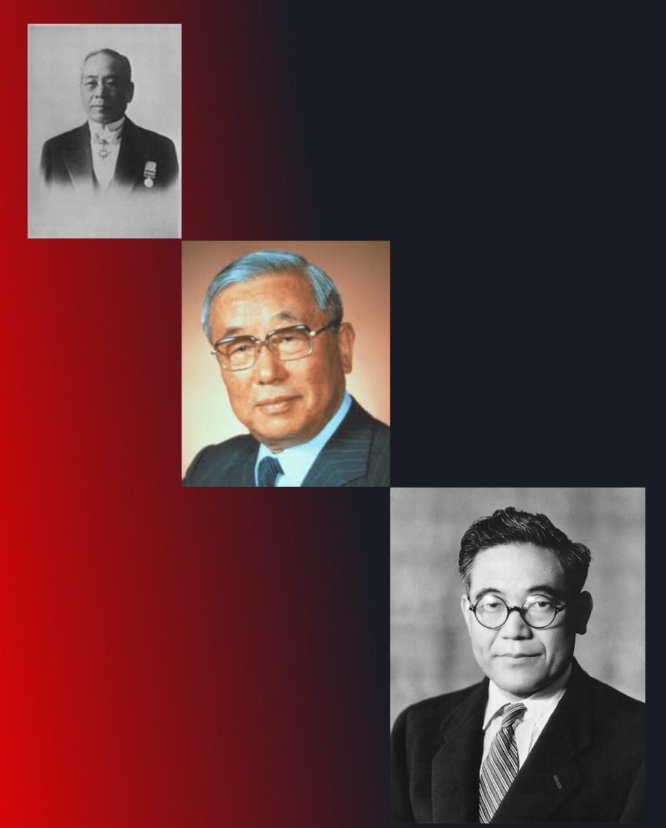
History of Lean
Introduction
Sakichi Toyoda developed the concept of jidoka (autonomation), which became one of the pillars of TPS. Founded Toyota Motor Co. in 1937.
Eiji Toyoda adapted the Ford suggestion scheme into a system for continuous improvement which became known as kaizen.
Kiichiro Toyoda studied Ford’s production system and adapted it to the smaller, more diverse Japanese market. Developed the key concepts
behind “just-in-time”
Notes:
Eiji Toyoda photo By Thejorge11 CC BY-SA 4.0, https://commons.wikimedia.org/w/index.php?curid=63145509
Sakichi Toyoda & Kiichiro Toyoda photos are public domain.

Slide 12
Taiichi Ohno and the Toyota Production System
Introduction
Toyota Production Model
Taiichi Ohno took the concepts from Sakichi Toyoda, Kiichiro Toyoda, and Eiji Toyoda and created a system called the Toyota Production System
Toyota Production Model
Just In Time
Jidoka
Standard
Work
Heijunka
Kaizen

Slide 13
Lean Fundamentals
Objectives
  Identify and explain core lean concepts
  Define and distinguish Value Added from Non Value Added activities
  Define “waste”
  Identify the 8 Wastes
  Define philosophy and principles of continuous improvement
  Conduct flow production exercise

Slide 14
Core Lean Concepts
Lean Fundamentals
    Specify Value
Identify the Value Stream
Flow
Pull
Perfection

Slide 15
Value Added vs. Non-Value Added
Lean Fundamentals
Non-Value Adding Processes
(NVA)
Those process steps that take time, resources, or space, but do not add value to the product or service
Value Adding Processes
A process step that transforms or shapes a product or service which is eventually sold to a customer
“Business Value Adding” Processes
A Non-Value Adding process that is required by law or regulation to operate the business
Example: Tax Filing
Something the customer wants
Transforms the product or service
Done right the first time

Slide 16

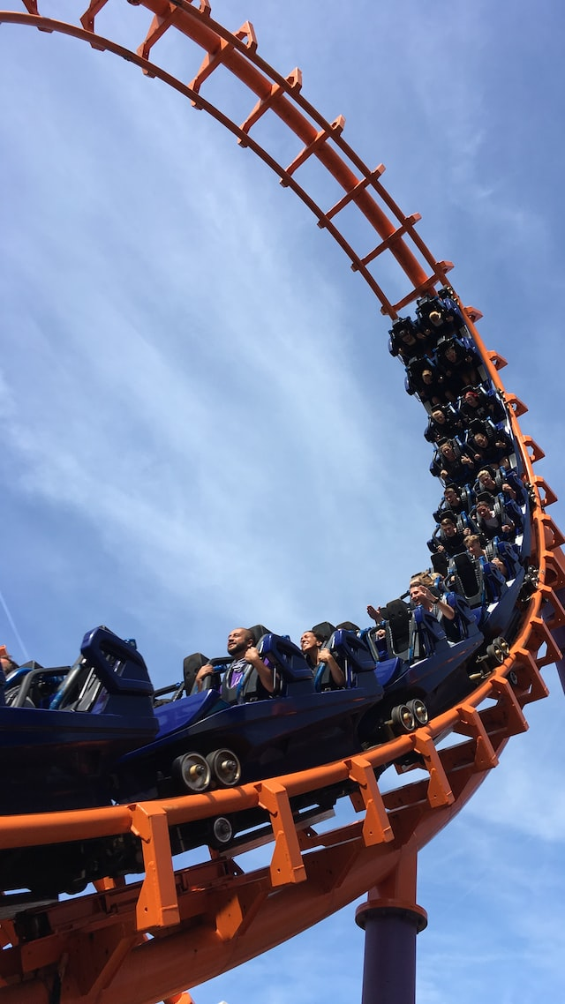
Tasks can only be defined as
“Value-adding” by the customer
Lean Fundamentals
How long will you spend at the hospital?
Registration
Waiting
Pre-screen
Diagnosis
How long will you be at the park?
Ride the rides
Wait in line
Eat the food
Play the games
What is the value?

Slide 17
Identifying Your Customers:
What do they value?
Lean Fundamentals
Lean focuses on providing the customer with what require, when needed, in the right amounts, and at the expected level of quality
Know who your customers are… both internal and external
  What are their requirements? Expectations?
Customers include both the next downstream process as well as the end user

Slide 18
Distinguish VA from NVA Activities
Lean Fundamentals
Activity | Internal Customer | External Customer
Selecting candidates to interview for hire | VA | NVA
Completing weekly expense report
Entering a customer order
Resolving a customer billing error by phone
Walking to the printer to pick up documents
Attending training to learn about a new software application
Getting specifications from the customer
Waiting for approval before completing a special transaction
Notes:
INSTRUCTIONS: Discuss each one of these. Have the class decide if they are value-added or non-value added activities in the eyes of both the ultimate customer and the customer who is the recipient of the process itself (if other than the ultimate customer).
e.g.: The end customer may not view reviewing resumes of candidates to interview for hire as value-added, but the supervisor of the department that has the open position may view that as value added.

Slide 19
What is “Waste”?
Lean Fundamentals
Terms originating from the Toyota Production System, and called the Three M’s
The Three M’s | Descriptions*
1. Muda | Any activity that consumes resources without creating value for the customer Aka: The Seven (or Eight) Wastes
2. Mura | Unevenness in an operation, inconsistency, shifting schedules or priorities, variation
3. Muri | Overburdening people and equipment by requiring them to run at a higher or harder pace with more force or effort for a longer period of time than equipment designs or appropriate workforce management allow
* Source: Lean Lexicon, 3rd Edition, Lean Enterprise Institute
Notes:
DO: Explain the three types of waste that originate from the Japanese.

Slide 20
Lean Fundamentals
The Eight Wastes Defined
Wastes | Definition
Defects | Process steps that result in scrap, rework or re-processing.
2. Over Production | Producing more product than is required at the current time.
3. Waiting | Periods of inactivity while waiting for the next process step to begin.
4. Non-Utilized Talent | Unused creativity and underutilized human capital.
5. Transportation | Product moving from person to person or between locations.
6. Inventory | Unprocessed or partially processed materials, or undelivered finished goods.
7. Motion | Excessive movement by people or machines.
8. Extra Processing | Unnecessary work beyond what is required to meet customer requirements.
Notes:
Mnemonics: DOWNTIME

Slide 21
Eight Wastes Examples
Lean Fundamentals
Wastes | Manufacturing Example | Office Example
Defects | Rejected parts that do not meet specifications, parts damaged during processing or transportation | Customer orders with incomplete information, rejected drawings and documents, revisions/iterations
2. Over Production | Producing more pieces than required, large batches, keeping machines “busy” | Working ahead of schedule, building up large transaction queues, keeping people “busy”
3. Waiting | Parts waiting to be processed by a machine or work cell | Time waiting to receive a quote from a supplier, turnaround time to get an approval
4. Non-Utilized Talent | Insufficient time devoted to continuous improvement, limited knowledge sharing | Insufficient time devoted to continuous improvement, limited knowledge sharing

Slide 22
Eight Wastes Examples (Con’t)
Lean Fundamentals
Wastes | Manufacturing Example | Office Example
5. Transportation | Parts that are hand-carried or moved by conveyor, hand truck, tow motor, truck, ship, plane. | Functional hand-offs (including electronic), document movement (physical or electronic)
6. Inventory | Accumulation of raw materials, WIP and finished goods stored in warehouses, or staging areas | Transactions/documents waiting in queue (e.g. incomplete customer order, unreleased engineering drawing)
7. Motion | Operators reaching for parts, bending, lifting, excessive movement within cell | Reaching, bending, unnecessary steps within office or work area
8. Extra Processing | Machining to overly tight tolerances, washing parts longer than required, excessive polishing | Excessive information, unnecessary reports, unnecessary approvals, excessive specifications

Slide 23
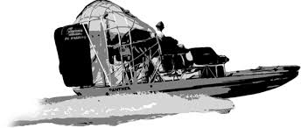
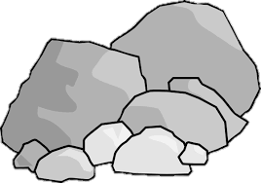
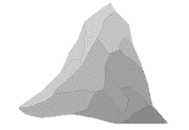
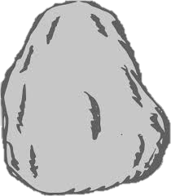
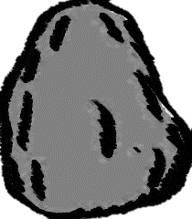

Lean Fundamentals
Sample Drivers of Waste
Sea of Excess Inventory, Manpower, Equipment
Long
No Standard Work
Set-Up
Time
Poor
Machine
Poor
Quality
Down-Time
Lack of
Scheduling
Training

Slide 24
Core Lean Concepts
Lean Fundamentals
    Specify Value
Identify the Value Stream
Flow
Pull
Perfection

Slide 25
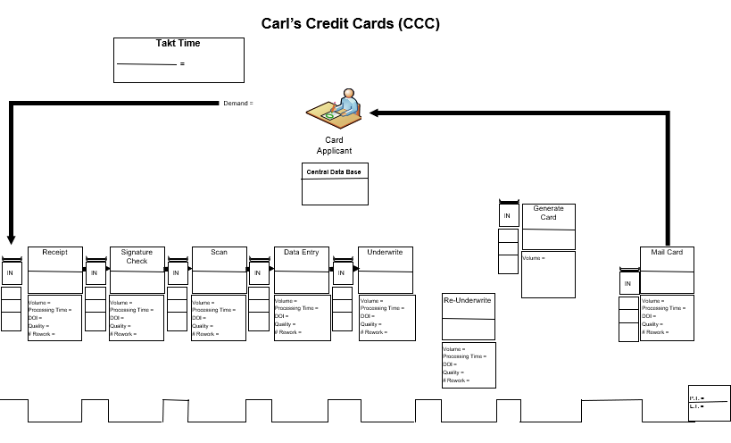
Define Value Stream
Lean Fundamentals
Value Added and Non-Value Added Processes
Product and Information Flow
Cross function and organization boundaries
From Initiation to the Customer
All of the actions required to bring a product or service through the main flows essential to providing that product or service from inception point to receipt by customer
Notes:
SAY: “VSM is a graphical representation that uses a common mapping language
VSM provides the basis and direction for identifying improvement opportunities
The power is in the plan!”

Slide 26
Multiple Passes through the Value Stream
Lean Fundamentals
Approx. ½ of time span from now to Future State
VS Plan
Implementation
Convergence
of future VSM and
long-term “Vision”
transformation
VSM
“Event”
New VSM “Event”
Value Stream
Plan
Kaizen events, other improvement and transformational activities
New Value Stream Plan
Future-State
VSM
New Future-State VSM
Begin implementation of
pacing transformation activities
(>6 months) required to achieve
long-term “vision”
Long-term
Vision
Notes:
SAY: “VSM is an incremental and repeatable cycle. Full optimization of the value stream sometimes isn’t realized until the third or fourth iteration.” For companies early on their journey it is common to reset the Current State Map and Future State Map and the VS Plan at the ½ way point – that is – if you set the Future State at one year out – you would reset at the 6 month point.”

Slide 27
Core Lean Concepts
Lean Fundamentals
    Specify Value
Identify the Value Stream
Flow
Pull
Perfection

Slide 28
Flow
Lean Fundamentals
Movement of information, services and knowledge through the value stream
A perfect process has continuous flow as information, service and knowledge are transformed continuously without delay from step to step
Flow is created by eliminating queues and stops, facilitating improved process flexibility & reliability
Notes:
SAY: “Then we look to establish opportunities to create flow. Continuous flow is defined as producing or completing one item at a time and then passing the item immediately to the next step.”
ASK: “What does continuous flow look like in your environment (ie: traffic, line at fast food station, train, supermarket, etc), “What does continuous flow look like in some of your daily processes at work?”

Slide 29
Batch Processes
Lean Fundamentals
Lead Time = 20 Minutes
Elapsed Time | 1 | 2 | 3 | 4 | 5 | 6 | 7 | 8 | 9 | 10 | 11 | 12 | 13 | 14 | 15 | 16 | 17 | 18 | 19 | 20
Receive Application | l | l | l | l
Enter Customer Data |  |  |  |  | l | l | l | l
Customer Lookup |  |  |  |  |  |  |  |  | l | l | l | l
Risk Review |  |  |  |  |  |  |  |  |  |  |  |  | l | l | l | l
Produce Card |  |  |  |  |  |  |  |  |  |  |  |  |  |  |  |  | l | l | l | l
Lead times are long because each process step is batched and must wait for the others to be completed before the next process can be started.
Notes:
SAY: “Characteristics of traditional batch processes:
Not customer focused, internally focused
Front Line Associates are focused on their task
Measurements considered bad
Cannot see flow from initiation to customer
High exposure to inventory ($)
Accountability difficult
Expediting is a primary method for short-term scheduling”
Organizations often go to batch processing because they feel that it makes them more efficient. Unfortunately this reflects an internal focus rather than a customer focus and sacrifices serving the customer to perceived organizational efficiency.”
ASK: “At what time does the first customer get served?” (answer: 17 minutes)
ASK: “Do you do any batch processing in your operation? Can anyone give me an example?”

Slide 30
Flow Processes
Lean Fundamentals
Lead Time = 8 Minutes
Elapsed Time | 1 | 2 | 3 | 4 | 5 | 6 | 7 | 8 | 9 | 10 | 11 | 12 | 13 | 14 | 15 | 16 | 17 | 18 | 19 | 20
Receive Application | l | l | l | l
Enter Customer Data |  | l | l | l | l
Customer Lookup |  |  | l | l | l | l
Risk Review |  |  |  | l | l | l | l
Produce Card |  |  |  |  | l | l | l | l
60% Reduction in
Lead Time
Lead times are long because each process step is batched and must wait for the others to be completed before the next process can be started.
Notes:
SAY: “ Single Piece Flow significantly reduces:
Lead time
Velocity/Through-put
Inventory
While improving:
Quality
Delivery
Cost”
By moving to a 1 piece flow environment we shift our focus externally to the customer. In this example we are using exactly the same Associates following exactly the same process steps using exactly the same process times but the result for the customer is significantly different”
ASK: “Now what time does the first customer get served” (answer: 5 minutes)

Slide 31
Core Lean Concepts
Lean Fundamentals
    Specify Value
Identify the Value Stream
Flow
Pull
Perfection

Slide 32
Pull
Lean Fundamentals
Couple processes with “pull” when flow is not possible
End Customer initiates pull process
Each step in the process takes the information or knowledge it needs, when needed from the preceding process
Only the amount required is taken
No action is taken until the downstream process initiates it
Notes:
SAY: “Now while we always strive for flow, flow may not always be possible. In these instance we look to establish pull. Pull is a method of controlling how much you are creating or providing between flows – ensuring the downstream process is only getting exactly what it needs when it needs it.”

Slide 33
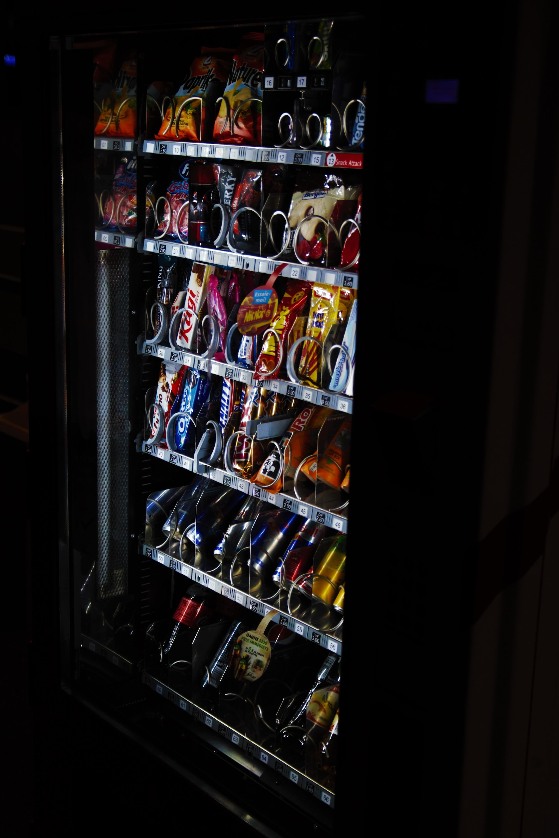
How is the classic vending machine an example of pull?
Lean Fundamentals
______________________
______________________
______________________
______________________
______________________
______________________
______________________
______________________
Notes:
DO: Have the class provide examples aloud. Capture their answers on a chartpaper. The participants can write their answers in their workbooks.

Slide 34
Exercise
Lean Fundamentals
Objective
Simulate a batch process operation.
Instructions
Time to Complete
Your instructor will assign various roles to the group.
Each team member is to write his/her name on each of 5 post-it notes When complete, pass the 5 post-its as a group to the next person in the sequence.
Record:
(1) Time it takes for the 1st post-it of the pack of 5 to be signed by all of the team members
(2) Time it takes for the last post-it of the pack of 5 to be signed by all of the team members
10 minutes
Deliverable
Chart and discuss results
Notes:
DO: Post-it® exercise batch flow.
Batch Process
Each team member is write their name on each of the five post-its.
When you completed this pass the five post-its as a group to the next person in the sequence.
Record two times for each team
The time it takes for the 1st post-it of the pack of five to be signed by all of the team members
The time it takes for the last pos-it of the pack of five to be signed by all of the team members
NOTE: Use Flip Chart to create Matrix
Trial
1st Last
Team
#1
#2
#3
#4

Slide 35
Exercise
Lean Fundamentals
Objective
Simulate a flow process operation.
Instructions
Time to Complete
In this trial, each team member is to write his/her name on
one of each of the 5 post-it notes. When complete, pass the post-it as a single piece to the next person in the sequence. Repeat this for the remaining post-its passing them as soon as they are signed and the next person is prepared to accept it. Do not pass the post-it until the next person is ready to accept it.
Record:
(1) Time it takes for the 1st post-it to be signed by all of the
team members
(2) Time it takes for the last post-it to be signed by all of the
team members
10 minutes
Deliverable
Chart and discuss results
Notes:
DO: Post-it® exercise One Piece Flow.
One Piece Flow Process
Each team member is write their name on one of the five post-its.
When you completed this pass the post-it as a single piece to the next person in the sequence.
Repeat this for the remaining post-its passing them as soon as they are signed and the next person in the sequence is prepared to accept it. Do not pass the post-it until the person is ready to accept it.
Record two times for each team
The time it takes for the 1st post-it of the pack of three to be signed by all of the team members
The time it takes for the last post-it of the pack of three to be signed by all of the team members
Use: Flip Chart to create Matrix
Trial 1 Trial 2 Delta
1st Last 1st Last
Team
#1
#2
#3
#4
DO: Compare the results of the two trials noting the % change in performance
SAY: “You all did something that you do multiple times everyday, sign your name, so there really wasn’t any learning curve involved. You did exactly the same thing using the same technologies. You didn't get a new IT system, or a preprinted form, or a faster pen, or slicker paper, it was all exactly the same except for the way you approached the process. And by changing the way you approached the process, by moving to one piece flow and focusing on the customer there was a significantly different result.”

Slide 36
Core Lean Concepts
Lean Fundamentals
    Specify Value
Identify the Value Stream
Flow
Pull
Perfection

Slide 37
Perfection
Lean Fundamentals
Continuous improvement never ends!
As we reduce inventory/overprocessing in the process, bottlenecks and other problems will be exposed
  Attack these and persevere! Do not go back to the old way!
Determine metrics to measure the processes – remember that what gets measured gets improved
Continue to find ways to improve the process
Always keep the customer in focus…are we adding value?
Notes:
SAY: “Keep the goal of continuous flow always in mind. While “pull” is the next best thing, pull is still a failure to flow.”
SAY: “Whenever we reduce inventory, we expose problems that had been covered up by that inventory. This is a good thing (although at first it may not feel that way). (ASK) Why is this a good thing?” (because you can’t solve problems that haven’t been identified).
SAY: “The commitment to striving for perfection is a big part of the cultural change that needs to take place. We need to acknowledge that everything that we do can be done better and striving for perfection is how we make continuous improvement a part of our everyday lives.”

Slide 38
Kaizen…. The philosophy of continuous improvement
Lean Fundamentals
Standardize/
Adherence
Kaizen \Ki-zen\
A continuous improvement mindset
Everything that we do today can be improved
Kaizen has no end
Kaizen
Process
Expose
and
Quantify
Problems
Implement
Solutions
Root Cause

Slide 39
Standardization and Kaizen
Lean Fundamentals
K
K
Improvement
K
K
K
K
K
K
Time

Slide 40
Waste Elimination Tools
Lean Fundamentals
    Visual Management
CEDAC
5S
Jidoka and Poka Yoke
Standard Work
SMED
Kanban
Total Productive Maintenance
Problem Solving
Cell Design
Production Preparation Process (3P)
Value Stream Mapping (VSM)
Transaction Process Improvement
Managing Daily Process Excellence

Slide 41
Waste Elimination Tools
Lean Fundamentals
    Visual Management
CEDAC
5S
Jidoka and Poka Yoke
Standard Work
SMED
Kanban
Total Productive Maintenance
Problem Solving
Cell Design
Production Preparation Process (3P)
Value Stream Mapping (VSM)
Transaction Process Improvement
Managing Daily Process Excellence

Slide 42
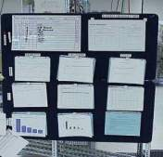
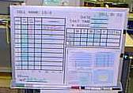
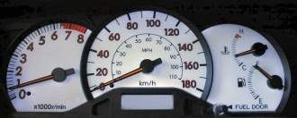
Visual Management
Lean Fundamentals
Visual Management allows us to separate the Normal from the Abnormal at a glance
This enables any level of the organization to very quickly find the focus for their efforts
If you don’t have visual management… how do you know what to work on?

Slide 43
Waste Elimination Tools
Lean Fundamentals
    Visual Management
CEDAC
5S
Jidoka and Poka Yoke
Standard Work
SMED
Kanban
Total Productive Maintenance
Problem Solving
Cell Design
Production Preparation Process (3P)
Value Stream Mapping (VSM)
Transaction Process Improvement
Managing Daily Process Excellence

Slide 44
5S Overview
Lean Fundamentals
1
2
3
Definition
Benefits
Expected Outcomes
Fundamental tool used to create workplace organization, improve productivity, and enable visual management
Used by all associates as a stand-alone tool or in conjunction with other lean tools
Allows for a safe work environment
Improves quality by eliminating the possibility of using rejected parts or wrong tools
Improves productivity by eliminating time spent searching
A clear understanding of the true business process
A neat, organized work environment
A place for everything and everything in its place
5S has been quoted as the most important of all lean tools

Slide 45
5S Process
Lean Fundamentals
Sort
(Seiri)
Straighten
(Seiton)
Scrub
(Seiso)
Stabilize
(Seiketsu)
Sustain
(Shitsuke)
Clearly distinguishing between what is necessary and what is unnecessary and disposing of the unnecessary.
Organizing the necessary items so that they can be used and returned easily.
Cleaning floors, equipment, and furniture in all areas of the workplace.
Maintaining and improving the standards of the first three S’s.
Achieving the discipline or habit of properly maintaining the correct 5S procedures.

Slide 46
Waste Elimination Tools
Lean Fundamentals
    Visual Management
CEDAC
5S
Jidoka and Poka Yoke
Standard Work
SMED
Kanban
Total Productive Maintenance
Problem Solving
Cell Design
Production Preparation Process (3P)
Value Stream Mapping (VSM)
Transaction Process Improvement
Managing Daily Process Excellence

Slide 47
Standard Work
Lean Fundamentals
1
2
3
Definition
Benefits
Expected Outcomes
Defines the interaction of people and their environment when processing a product or service
A set of tools used to improve productivity/capacity
Stabilizes a process
Improves productivity
Eliminates waste from processes
Provides a basis for improvement by defining the normal and highlighting the abnormal
Detailed work sequence of the process
Enables process consistency
Enables management at a glance
Tools, materials, and work instructions defined

Slide 48
Three Elements of Standard Work
Lean Fundamentals
Elements
Descriptions
Takt Time
How often should one part be produced based on the rate of sales to meet customer requirements
Usually expressed in seconds
1
2
Work Sequence
The specific order in which an operator performs the manual steps of a process for one part
3
Standard WIP
The minimum amount of parts on a line that will allow the operator to flow product efficiently

Slide 49
Waste Elimination Tools
Lean Fundamentals
    Visual Management
CEDAC
5S
Jidoka and Poka Yoke
Standard Work
SMED
Kanban
Total Productive Maintenance
Problem Solving
Cell Design
Production Preparation Process (3P)
Value Stream Mapping (VSM)
Transaction Process Improvement
Managing Daily Process Excellence

Slide 50
Kanban
Lean Fundamentals
1
2
3
Definition
Benefits
Expected Outcomes
Kanban means “signal” as in to signal for more material
Signals both starting production and stopping production
Used to overcome current “obstacles” to flow
Kanban in itself is 100% Waste
Reduction in Inventory ($)
Improve On-Time-Delivery
Enables flow (through proper use of waste)
Easier to identify and solve problems
Improves scheduling frequency from ‘daily or weekly’ to ‘real time’
Separates process velocity from MRP velocity
Enhances control of lumpy processes
Enables visual scheduling (where ‘scheduling’ is necessary)
Right-sizes use of inventory, people and equipment

Slide 51
Waste Elimination Tools
Lean Fundamentals
    Visual Management
CEDAC
5S
Jidoka and Poka Yoke
Standard Work
SMED
Kanban
Total Productive Maintenance
Problem Solving
Cell Design
Production Preparation Process (3P)
Value Stream Mapping (VSM)
Transaction Process Improvement
Managing Daily Process Excellence

Slide 52
CEDAC
Lean Fundamentals
1
2
3
Definition
Benefits
Expected Outcomes
A team-based problem solving approach
Used when you need to identify, explore, and display the possible causes and potential solutions to a specific problem or condition
Brings problem solving “out of the meeting room”
Involves everyone in the continuous improvement process
Covers every step in the problem solving process in one technique
Effective brainstorming leads to implemented solutions targeted to specific problem

Slide 53
Waste Elimination Tools
Lean Fundamentals
    Visual Management
CEDAC
5S
Jidoka and Poka Yoke
Standard Work
SMED
Kanban
Total Productive Maintenance
Problem Solving
Cell Design
Production Preparation Process (3P)
Value Stream Mapping (VSM)
Transaction Process Improvement
Managing Daily Process Excellence

Slide 54
Poka-Yoke: Error-Proofing
Lean Fundamentals
1
2
3
Poka-Yoke
Jidoka
Examples
A Japanese term meaning, “mistake-proof”
  Inadvertent errors (Poka)
  To avoid (yokeru)
A method of designing processes that will prevent errors
Also referred to as “autonomation”, means a method of transferring human intelligence to the process
The process detects abnormalities and stops when detected
Computer diskettes can only be inserted into the drive one way
Automatic seat belts
Auto shut-off irons and other appliances
Automatic sinks in public restrooms
Low clearance barriers in parking garage
“Poka-Yoke” is the highest level of Jidoka

Slide 55
Waste Elimination Tools
Lean Fundamentals
    Visual Management
CEDAC
5S
Jidoka and Poka Yoke
Standard Work
SMED
Kanban
Total Productive Maintenance
Problem Solving
Cell Design
Production Preparation Process (3P)
Value Stream Mapping (VSM)
Transaction Process Improvement
Managing Daily Process Excellence

Slide 56
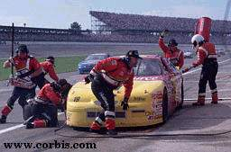
SMED Definition
Lean Fundamentals
SMED
Definition
Single Minute Change of Dies or decreased set-up time
Set-up time should be less than
takt time
Purpose of SMED
Reduces the need for inventory
Provides more capacity and flexibility
Enables serving the customer better!
Shigeo Shingo believed that any set-up time could be reduced by 59/60ths

Slide 57
Waste Elimination Tools
Lean Fundamentals
    Visual Management
CEDAC
5S
Jidoka and Poka Yoke
Standard Work
SMED
Kanban
Total Productive Maintenance
Problem Solving
Cell Design
Production Preparation Process (3P)
Value Stream Mapping (VSM)
Transaction Process Improvement
Managing Daily Process Excellence

Slide 58
What is TPM?
It is an approach to maximize the effectivity of the plant’s equipment in the areas of uptime, speed, and quality.
It is an approach that utilizes the experience and talent of the operator, the maintenance technician, and engineering as a team
It goes beyond simply restoring and repairing the equipment. It includes sustaining processes and continuous improvement
It improves the efficiency of those people involved in the setup, operation and maintenance of the equipment

Slide 59
Lean Transformation
Objectives:
Discuss what is a Lean Transformation
Summary
Review

Slide 60
Review: What is a Lean Transformation?
Lean Transformation
Integration of Lean to achieve business imperatives
Demonstrated Executive and Leadership Commitment
Culture Development
Significant movement in key financial and performance metrics
Leveraging the operational capability
Assess optimization at all levels
Enterprise-wide strategy
Learning to lead a Lean organization
Infrastructure to support continuous improvement
Problem solving at the lowest level in the organization
Creating a “learning organization”
Process execution/awareness
Employee development
Lean Transformation

Slide 61
Steps to Transform into a Lean Organization
Lean Transformation
Introduce
Stabilize
Accelerate
Transform
Leadership commitment
Creating a crisis
Engagement at all levels
Systems approach to Lean Transformation
Monitoring progress
Replicating new best practices
Celebrating and rewarding success
Widely communicate lessons learned
Lean is the “go to” way to drive improvement
Lean becomes a true competitive advantage
Talent hired and promoted based on ability to drive Lean
Everyone is at a different place in their journey
Notes:
ASK: “Where are you in this journey?”

Slide 62
Enterprise
Lean
Excellence
Lean Transformation
Administration
Culture:
Strategic
Development &
Deployment
Employee Development,
Employee Involvement
Lean
Transformation
Product
Development
Logistics
Manufacturing
Notes:
SAY: “The key take-away from this graphic is that true Lean transformation takes place when Lean activity is the “go-to” way to drive improvements in all areas of the business: Administration, SD, Logistics, Manufacturing, Product Development, Employee Development/HR, etc.”

Slide 63
In a Lean Journey, there is no end…
Lean Transformation
Lean in its most basic form simply helps us “Identify Waste.”
Waste exists in multiple levels in all aspects of our business
Realities and changes in the competitive landscape influence the “Business Imperatives” at any given time
What may begin as a Capacity opportunity may quickly shift to New Product Introduction (velocity) or Cash flow for the business
Different product families and different distribution channels will present varying ‘opportunities’
Notes:
SAY: “Overall; Lean is about having a process to use everybody's "brains“ to understand what is important for the customer, and identify and eliminate waste consistently.”

Slide 64

2-Minute Review
Turn to the person next to you and spend 2 minutes sharing your top learnings from today’s session.
When the time is complete, each pair must share one item that was discussed with the rest of the class

Slide 65
Other Modules In This Series
5S
Standard Work
Total Productive Maintenance (TPM)
Administrative Lean
Cell Design/ Production Preparation Process (3P)
Kaizen
Kanban
Problem Solving
Poka Yoke Quality Systems
Transaction Process Improvement (TPI)
Cause & Effect Diagram with the Additions of Cards (CEDAC)
Single Minute Exchange of Dies (SMED)
Value Stream Mapping (VSMi®)
Visual Management
Managing Daily Process Excellence
For More Information Please Contact:
Mark DeLuzio, President and CEO
+1.860.234.0915
mark.deluzio@leanhorizons.com

